Slide 1
MANAGER SELF SERVIVCE TRAINING
TIME & ATTENDANCE

Slide 2
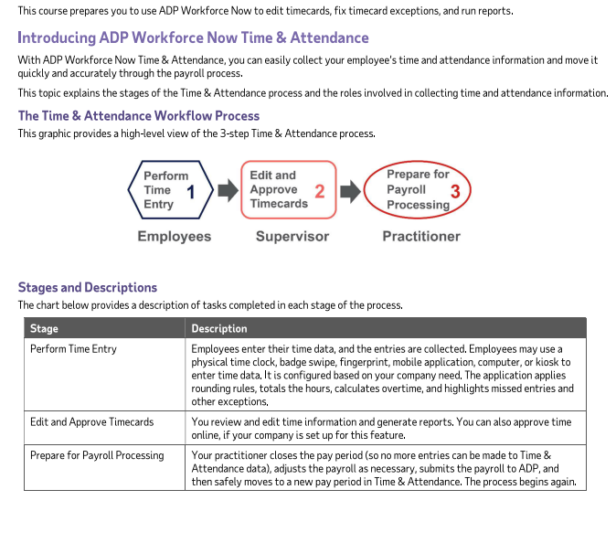
OVERVIEW

Slide 3
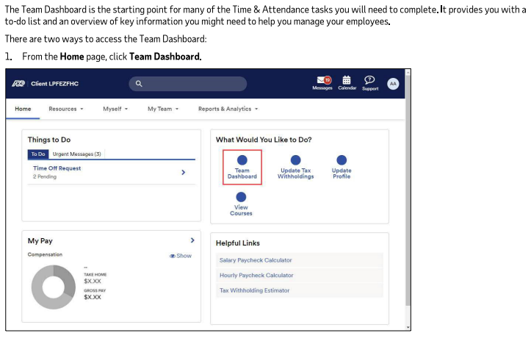
THE TIME & ATTENDANCE TEAM DASHBOARD

Slide 4
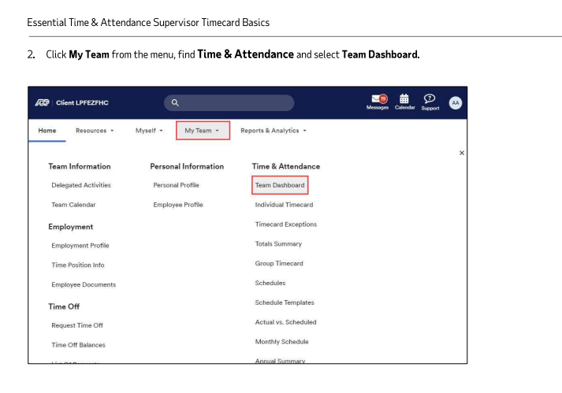

Slide 5
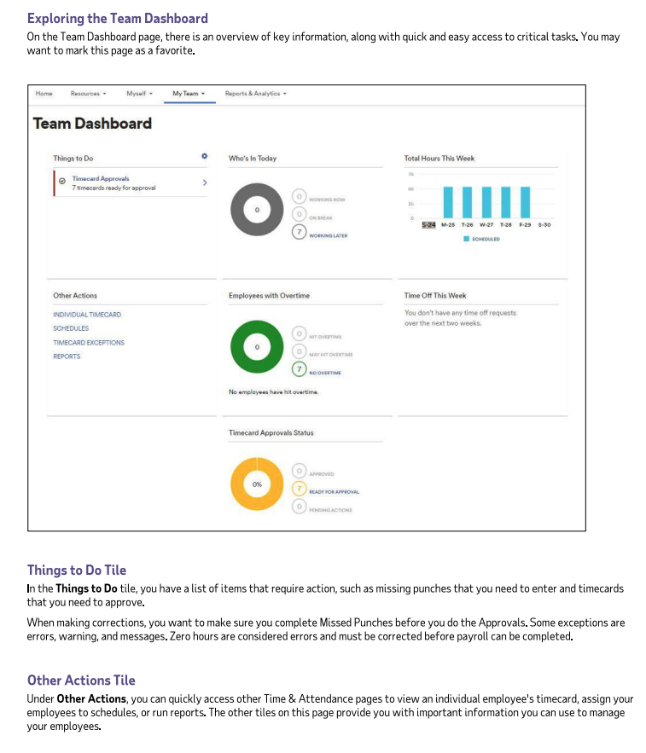

Slide 6
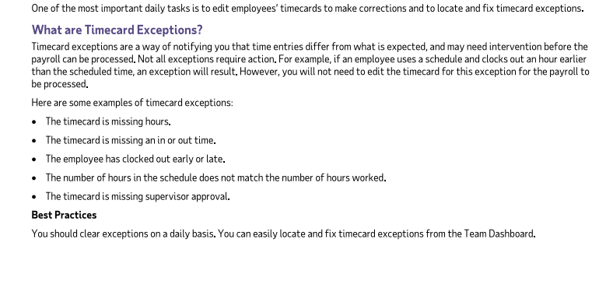
EDITING TIMECARDS

Slide 7
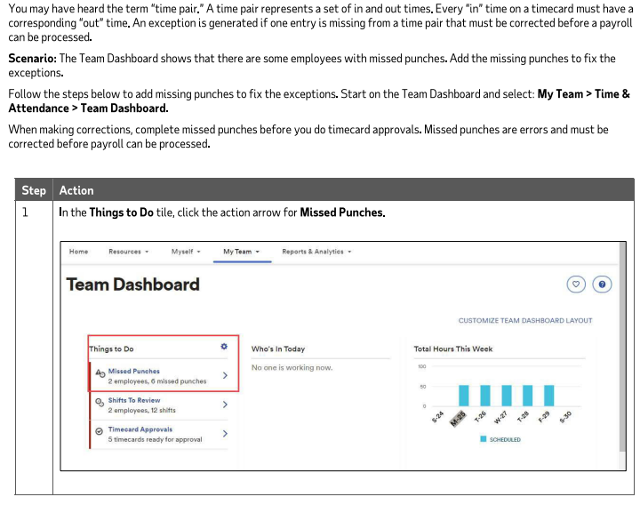
ADDING MISSED PUNCHES

Slide 8
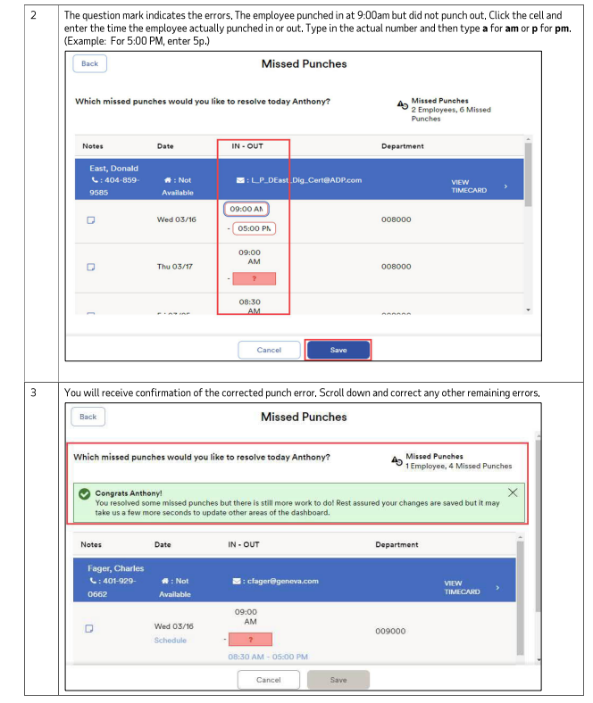

Slide 9
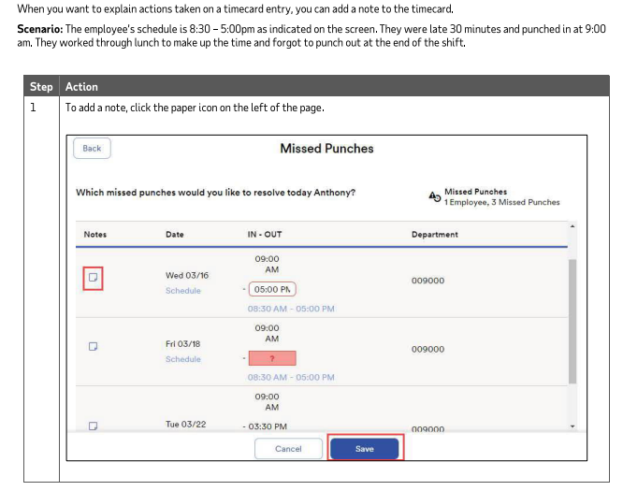
ADDING NOTES TO A TIMECARD ENTRY

Slide 10
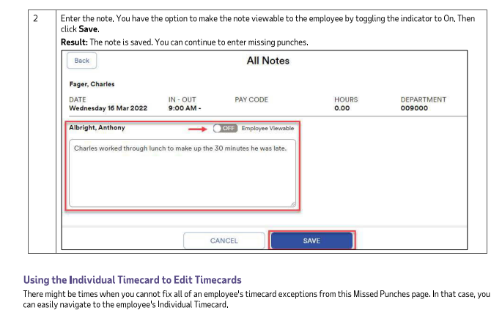

Slide 11
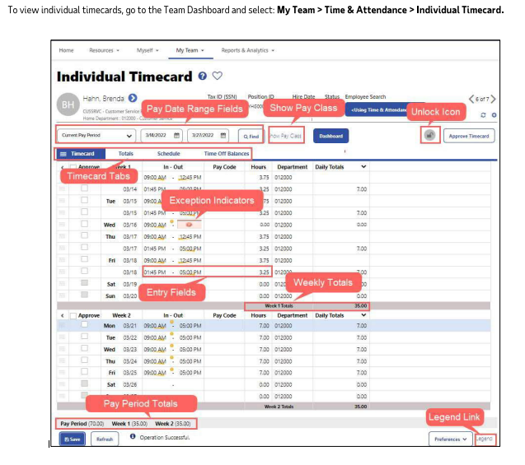
REVIEW INDIVIDUAL TIMECARDS

Slide 12
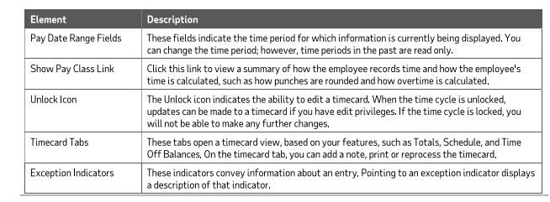

Slide 13
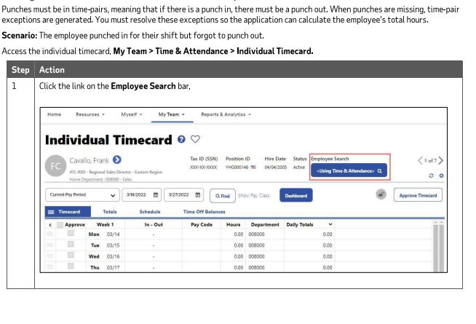
ADDING MISSED PUNCHES TO CORRECT A TIME PAIR EXCEPTION

Slide 14
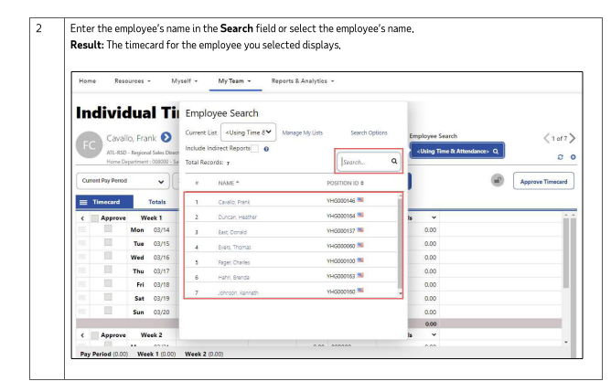

Slide 15
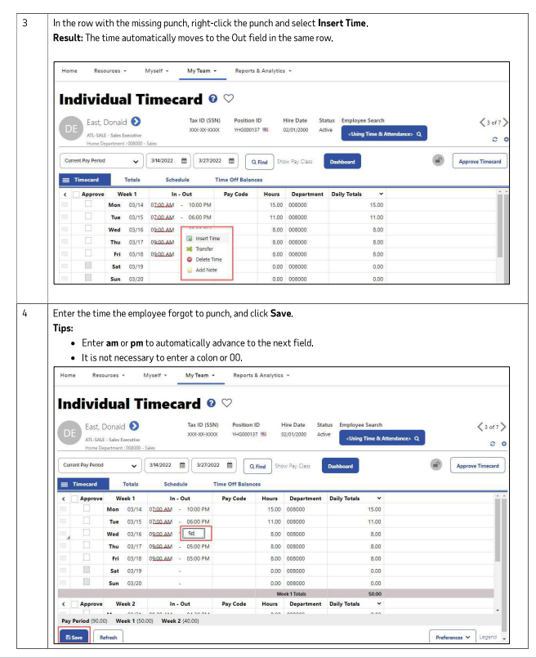

Slide 16
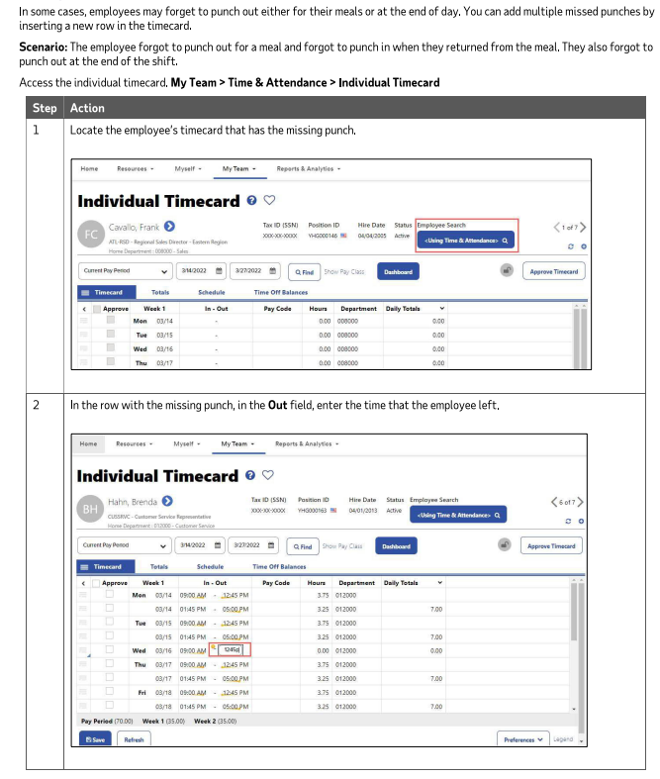
ADDING MISSED TIMED OUT/TIME IN PUNCHES

Slide 17
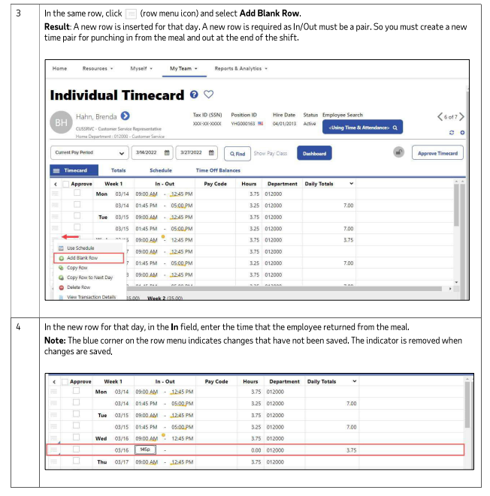

Slide 18
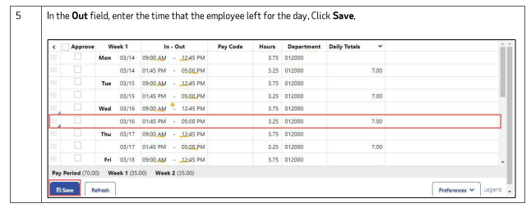

Slide 19
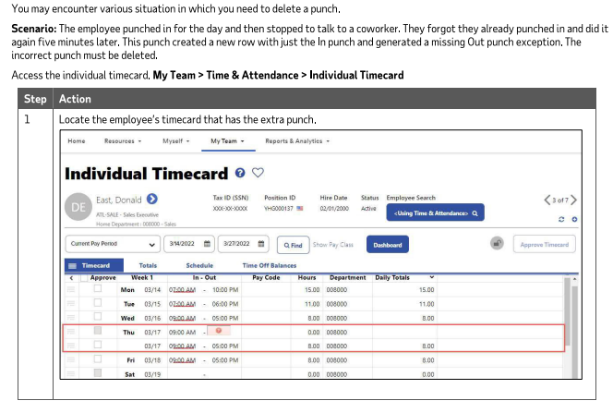
DELETING PUNCHES

Slide 20
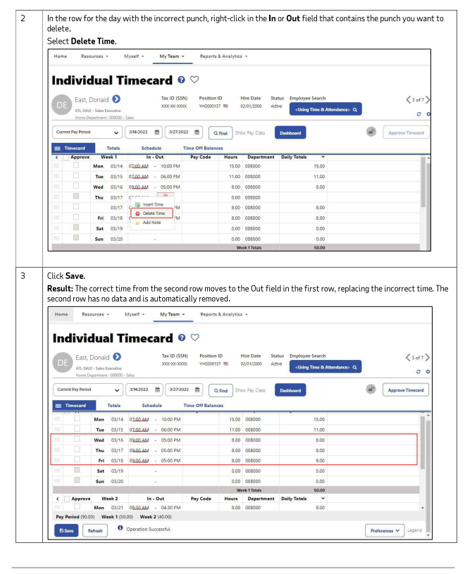

Slide 21
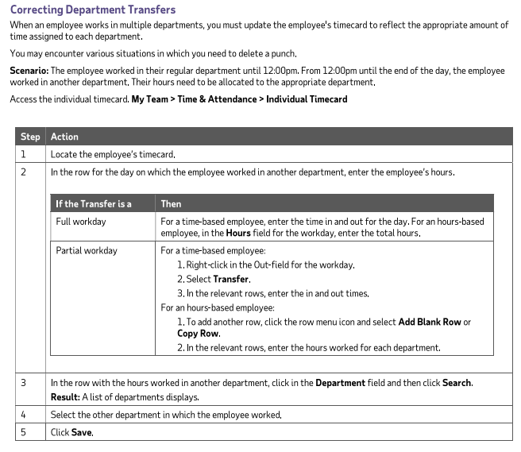
CORRECTING DEPARTMENT TRANSFERS

Slide 22
CONGRATULATONS!
You have learned how to edit timecards and fix various exceptions including:
Missed Punches
Deleted Punches
Correct Department Transfers
Feel free to reach out to Human Resources with questions.

